Slide 1
Promoting lingering through tangible interaction in residual urban spaces
Sophia Schulz (they/she)

Slide 2
How can tangible interactive technologies be used to transform residual urban space to support lingering as a form of engagement with such space?
Notes:
Note the vague ‘why’ – will be informed by chosen site for thesis portion (could be connecting users with a historical/cultural/environmental narrative relevant to the space, or with the materiality of the space, or improving social connection, etc.). Many of these possibilities relate to the concept of place identity.
In terms of general historical, socio-cultural and political context for my topic: rapid urbanisation, which leads to creation of residual spaces, and less lingering time as a result (one study finding lingering has decreased by half from 1980 to 2010, and frequency of group encounters has declined in public space – Salazar-Miranda)

Slide 3
Aim: design of a full-scale installation for a chosen site (TBD), either located within this site or as a representative gallery installation.
Notes:
Note the missing ‘why’ – will be informed by chosen site for thesis portion (could be connecting users with a historical/cultural/environmental narrative relevant to the space, or with the materiality of the space, or improving social connection, etc.). Many of these possibilities relate to the concept of place identity.
In terms of general historical, socio-cultural and political context for my topic: rapid urbanisation, which leads to creation of residual spaces, and less lingering time as a result (one study finding lingering has decreased by half from 1980 to 2010, and frequency of group encounters has declined in public space – Salazar-Miranda)

Slide 4
Why tangible interaction?
Methodologies and fields of inquiry: tangible interaction (Eva Hornecker), embodied interaction (Paul Dourish), tangible user interfaces and ambient media (Hiroshi Ishii), affordance theory (Don Norman)
Notes:
Explain my hunch for tangible interaction
(tie back to the whispering graffiti paper results ?? Would need to add to references)

Slide 5
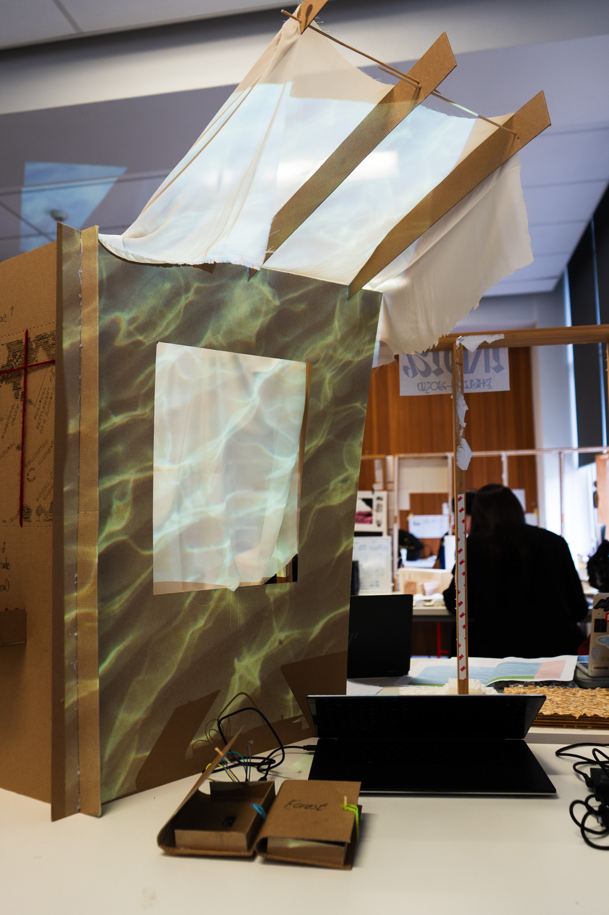
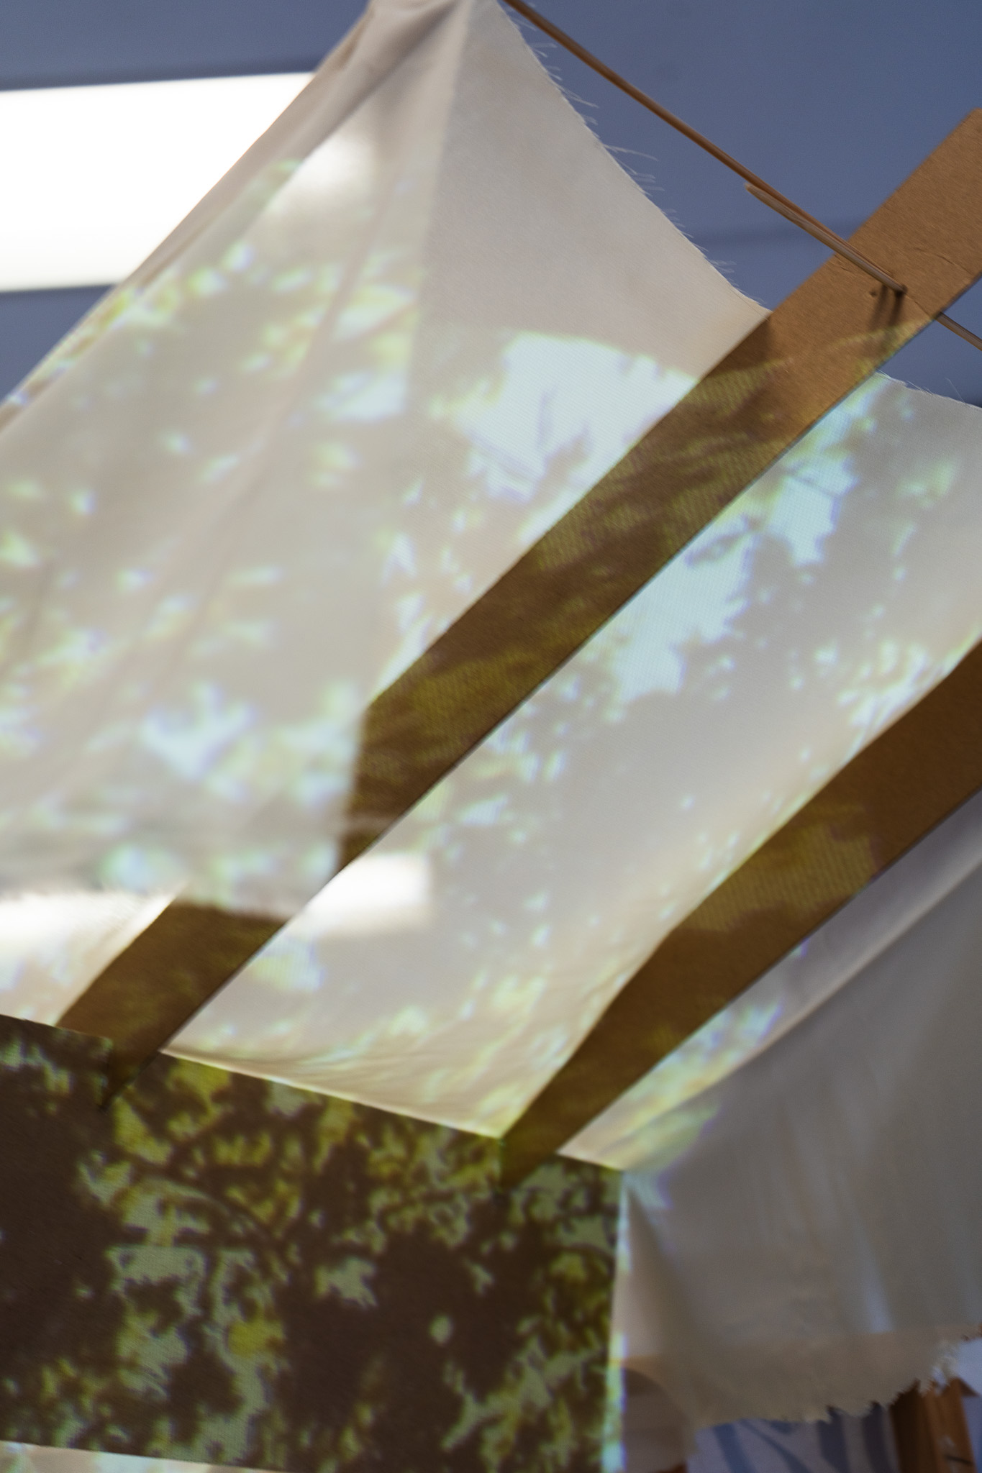
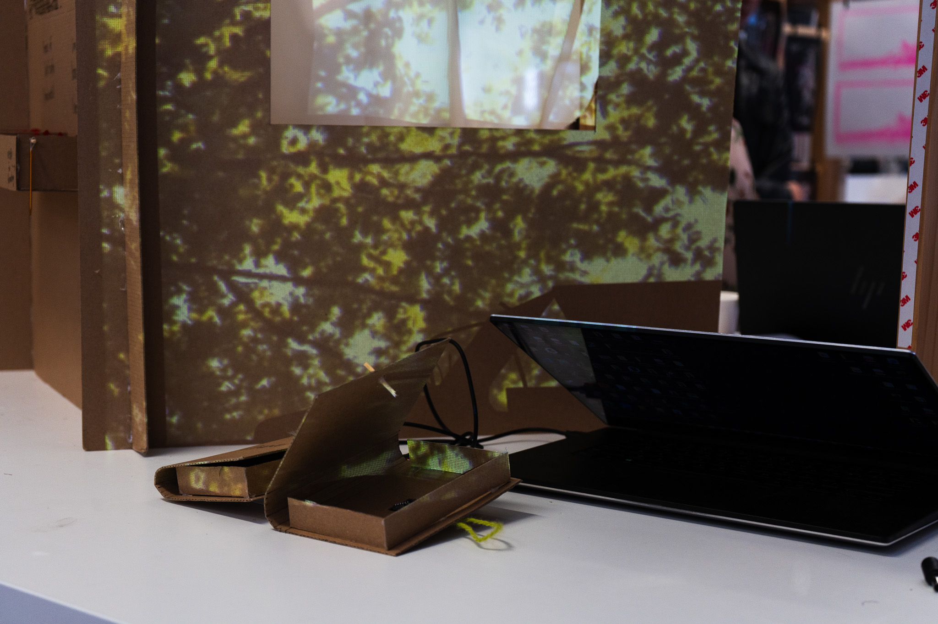
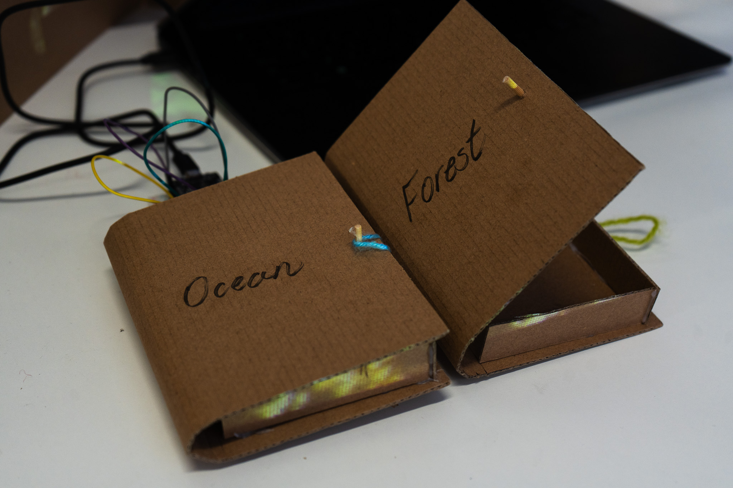
Design Practice I Week 4 Output
Note. Photographs by Sophia Schulz, 2026.
Notes:
Ambient media, atmosphere, affordance theory (with book “trigger”)
Rationing: working with cardboard for quick prototyping (less focus on quality and more focus on exploration/experimentation), again exploring full-scale interaction

Slide 6
Reflections on the Wānanga
Don’t rely solely on cognitive power or external knowledge – intrinsic and embodied knowledge is also valuable (Johnstone, 2026).
Concept of Ongo, incorporating both sound and feeling (Faletau, 2026).
Important experiences are stored in our senses (Johnstone, 2026).
Notes:
karl, sione

Slide 7
Why residual urban space?
Methodologies and fields of inquiry: urbanism (William Whyte), leftover / lost space vs. found space (Roger Trancik), loose space (Loose Space, 2006)
Notes:
Emphasis on public access of these spaces

Slide 8
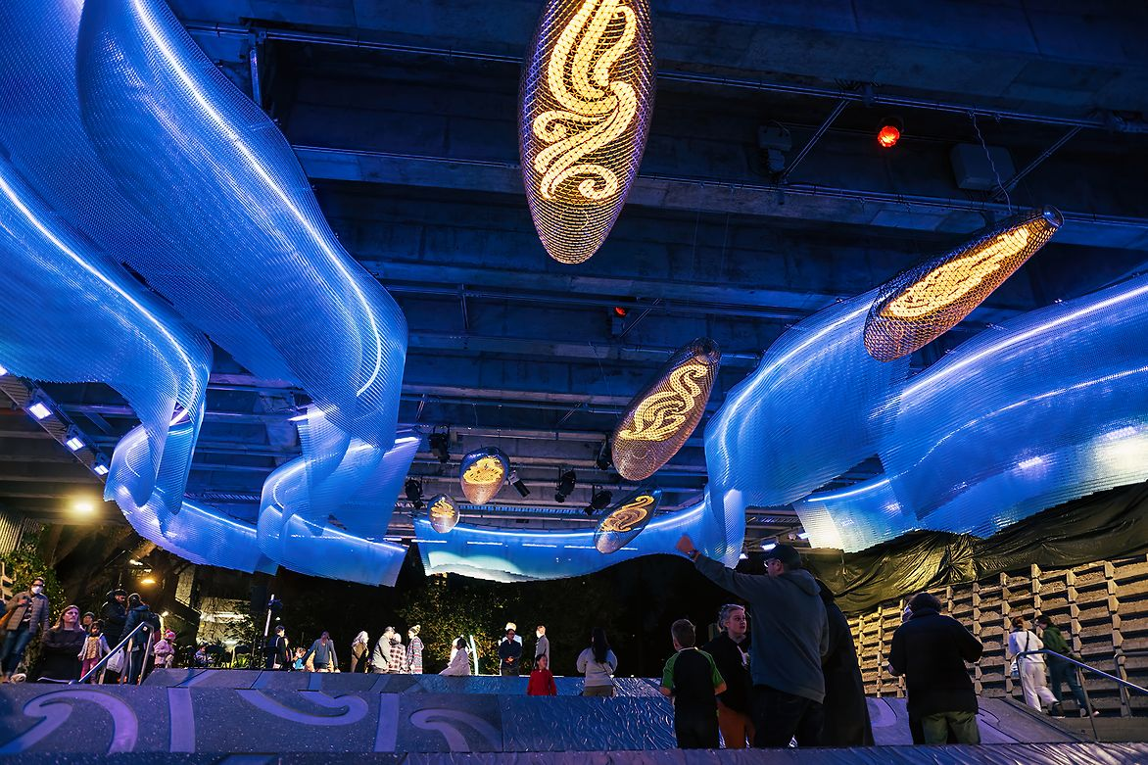
Waimahara: Interactive Art Installation
Note. From Waimahara, by Studio Local, 2025, Best Design Awards. https://bestawards.co.nz/spatial/private-public-and-institutional-spaces/studio-local/waimahara-1/

Slide 9
Why lingering?
Methodologies and fields of inquiry: phenomenology, atmospheric architecture (Juhani Pallasmaa, Olafur Eliasson, Gernot Böhme), sense of place

Slide 10
“The time spent lingering in these spaces has halved across all locations … the frequency of group encounters declined, indicating fewer interactions in public spaces. This shift suggests that urban residents are using streets as thoroughfares rather than as social spaces.”
(Salazar-Miranda et al., 2025)
Notes:
Study looking at public spaces in new York, boston and Philadelphia.
Impact of urbanisation as well

Slide 11
Methods
Observational site analysis (William Whyte), user testing, qualitative and quantitative analysis of lingering, rapid prototyping with digital and physical technologies/materials.

Slide 12
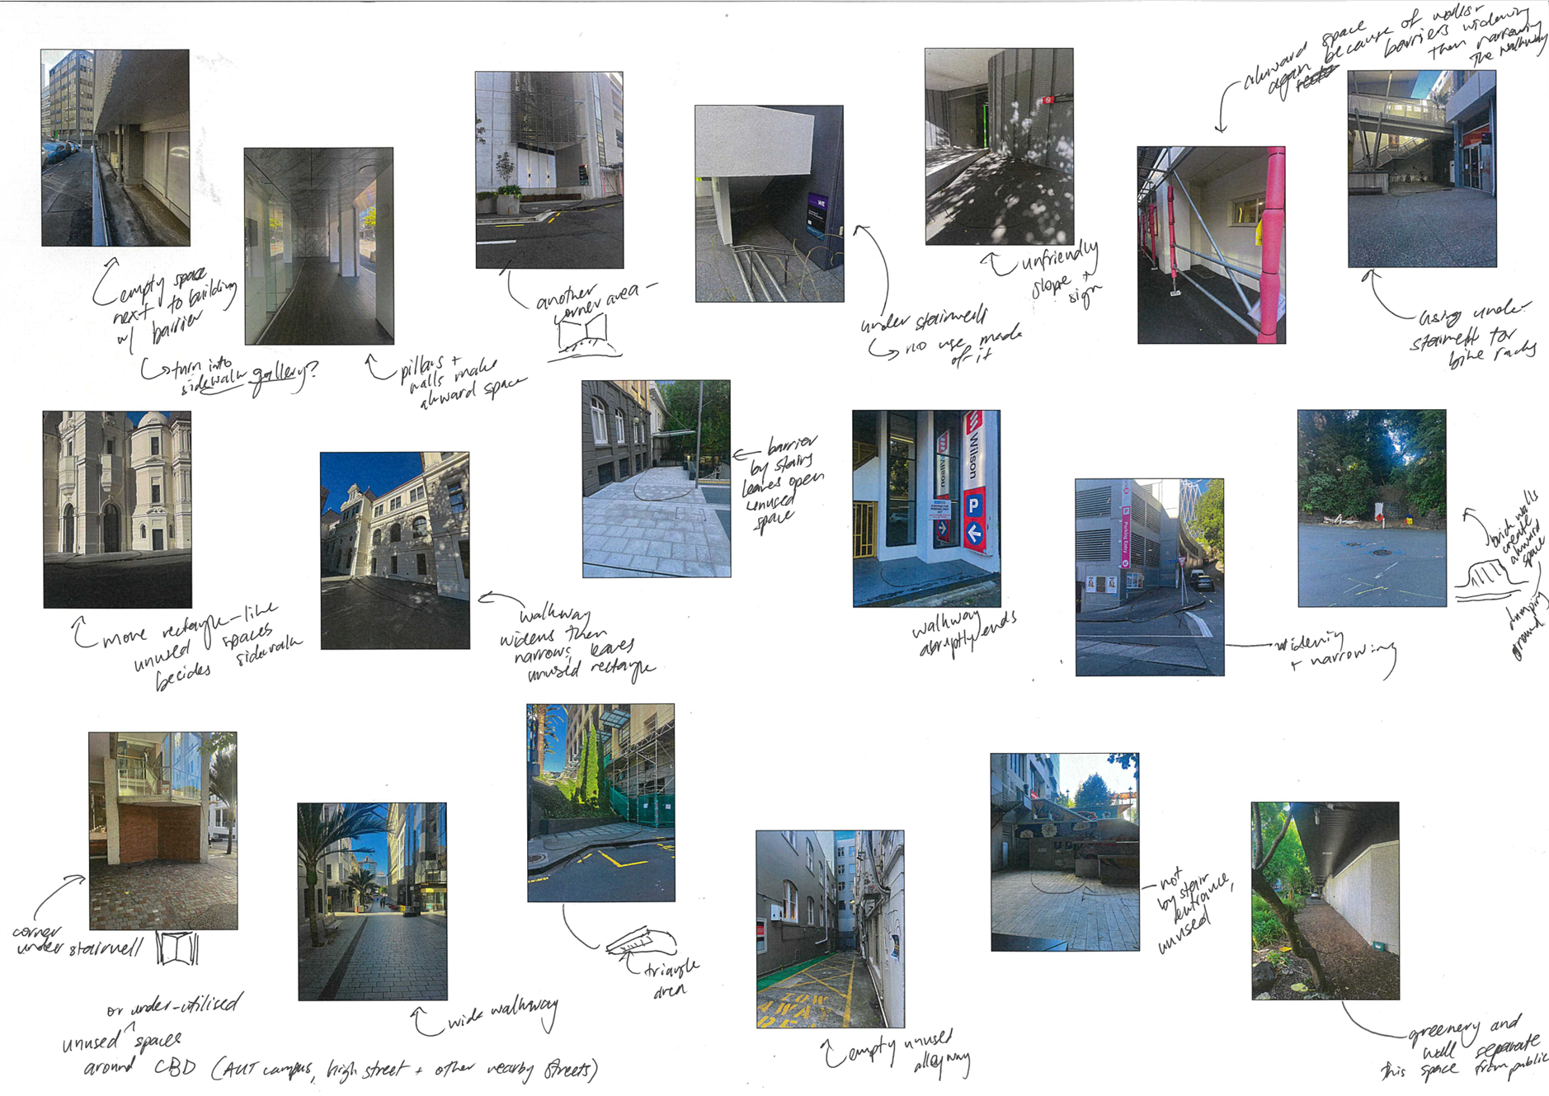
Design Practice I Week 2 Output
Note. Photograph by Sophia Schulz, 2026.
Notes:
New process: photo walks

Slide 13
Methods
Observational site analysis (William Whyte), user testing, qualitative and quantitative analysis of lingering, rapid prototyping with digital and physical technologies/materials.

Slide 14
Methods
Observational site analysis (William Whyte), user testing, qualitative and quantitative analysis of lingering, rapid prototyping with digital and physical technologies/materials.

Slide 15
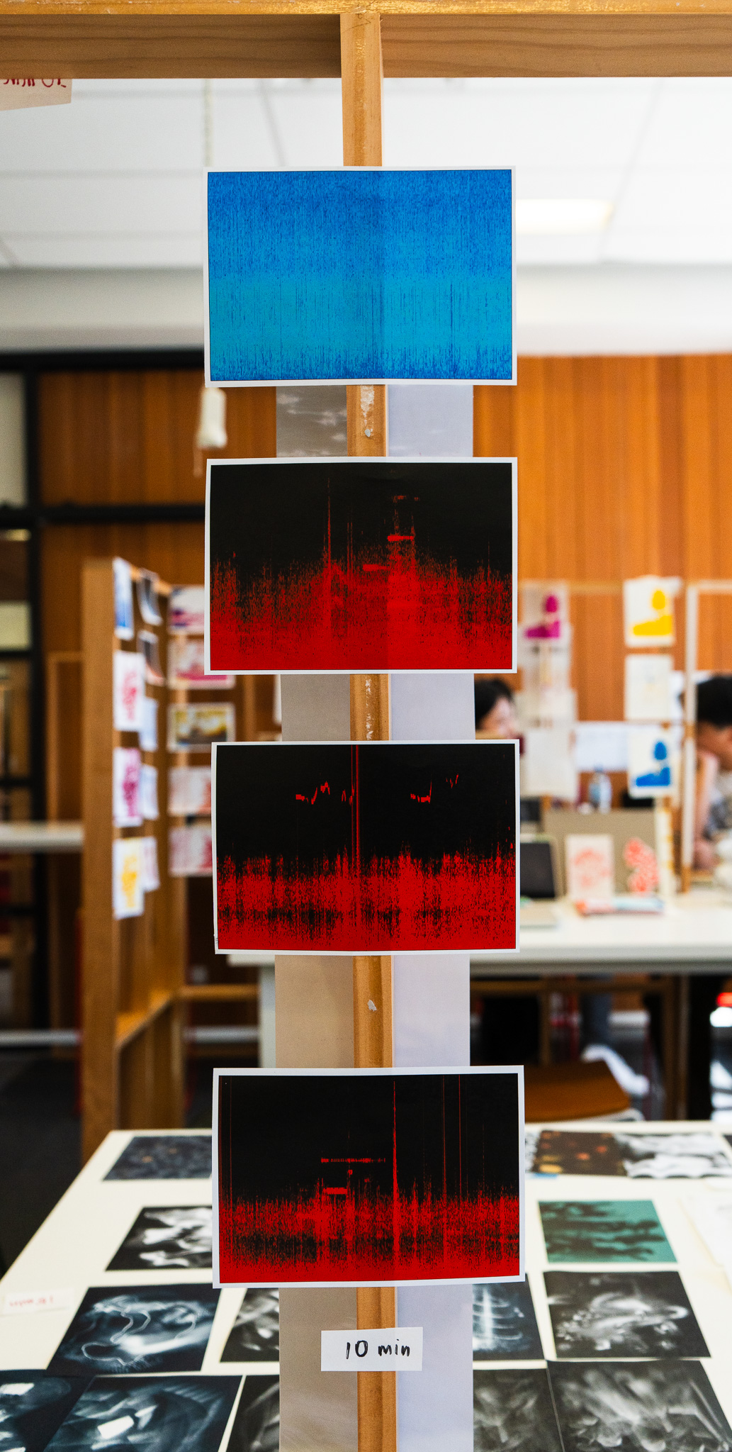
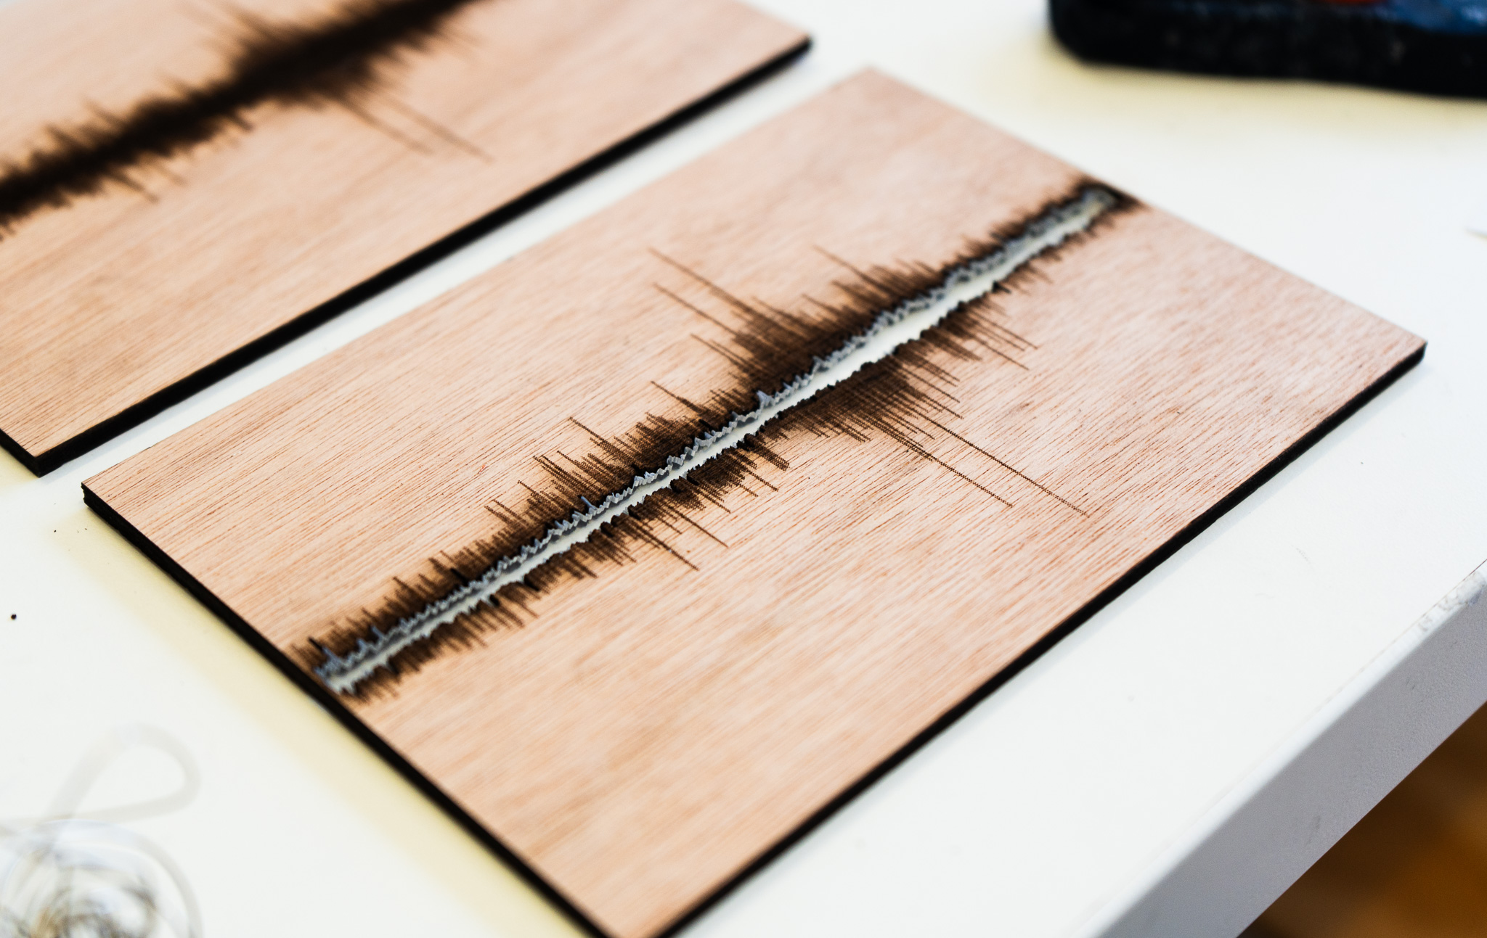
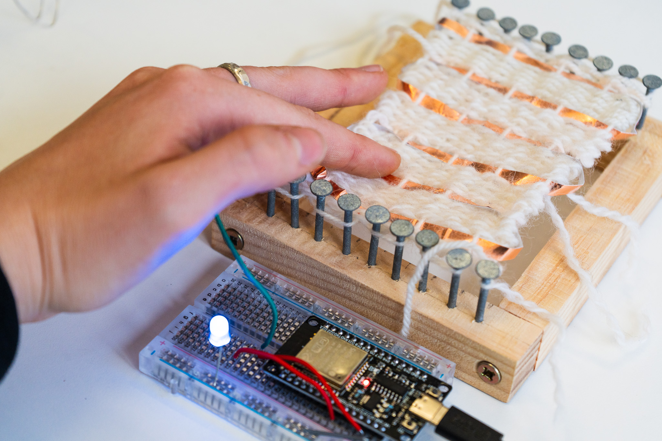
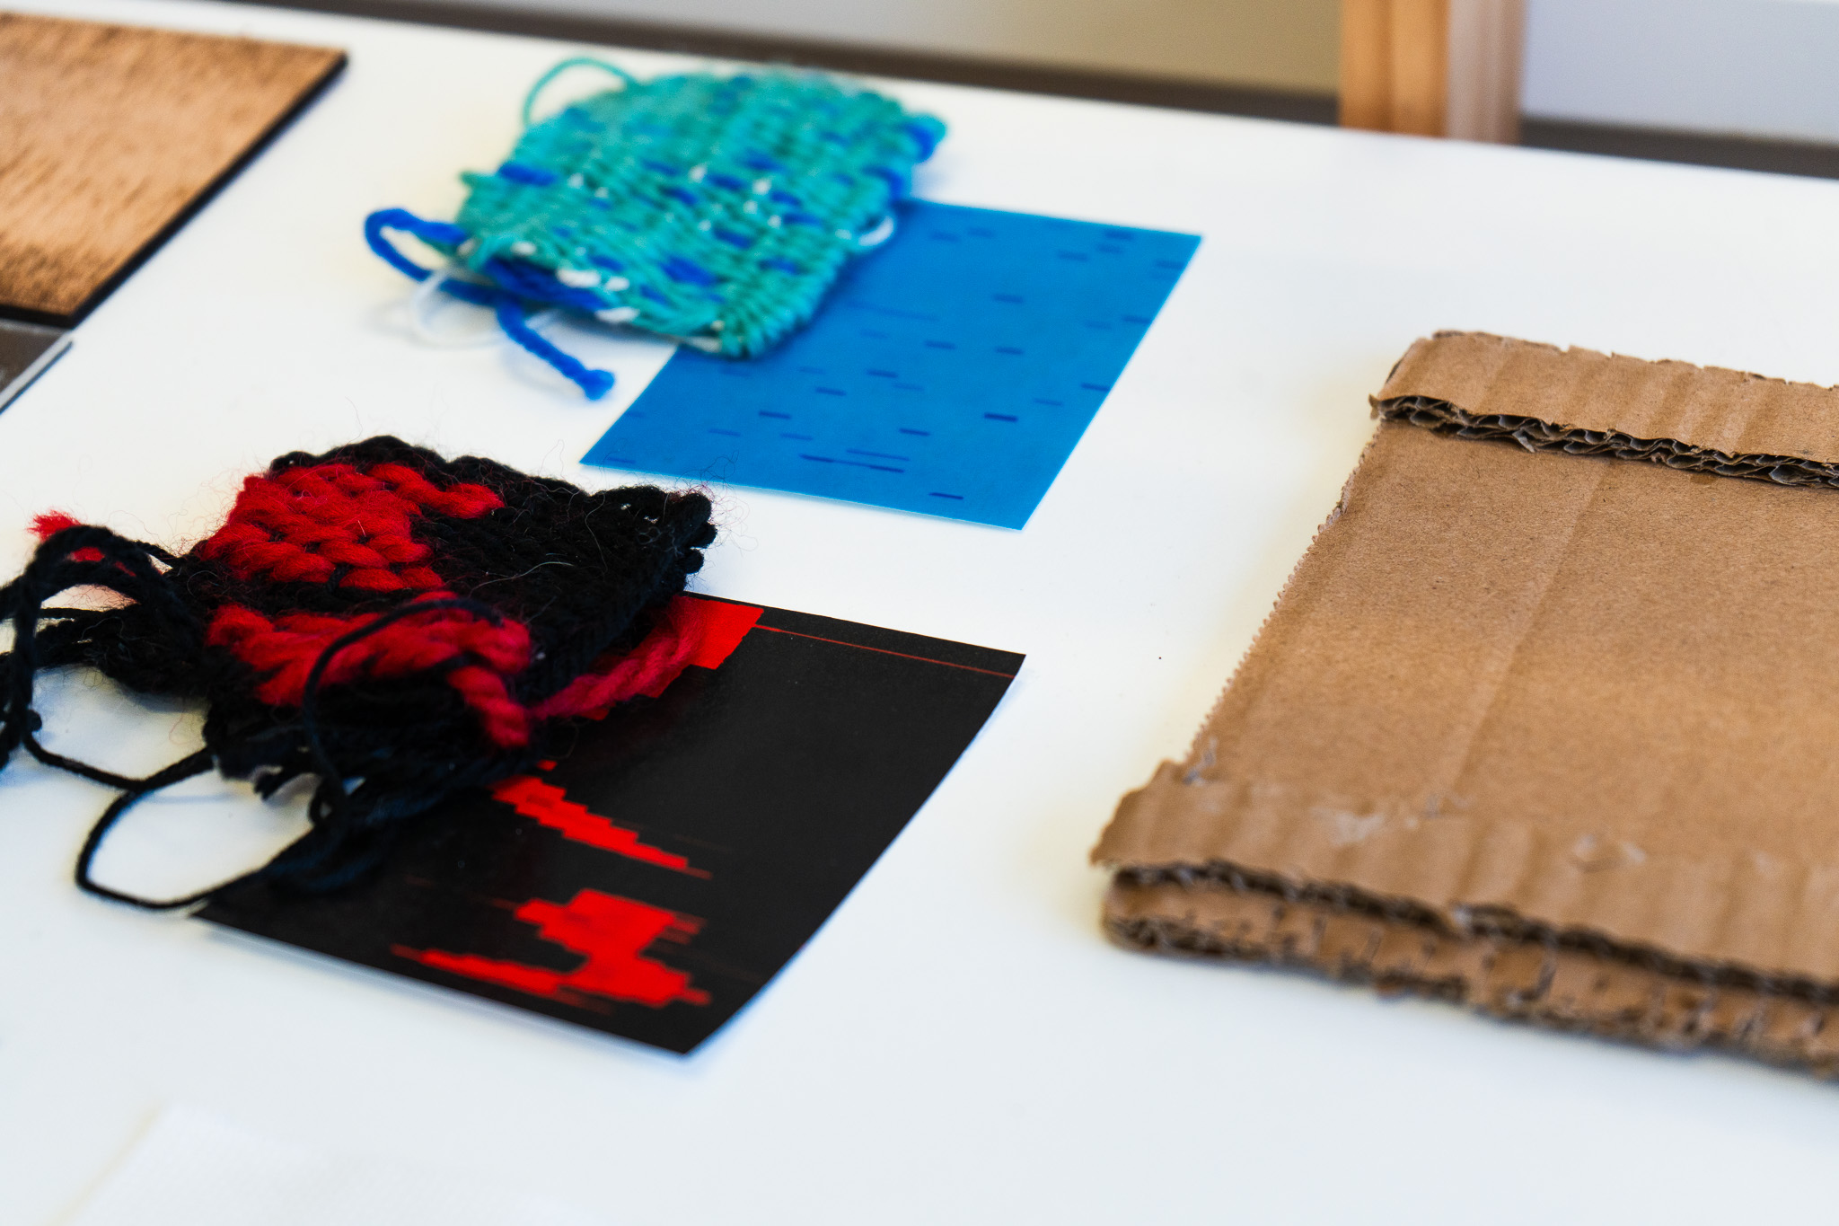
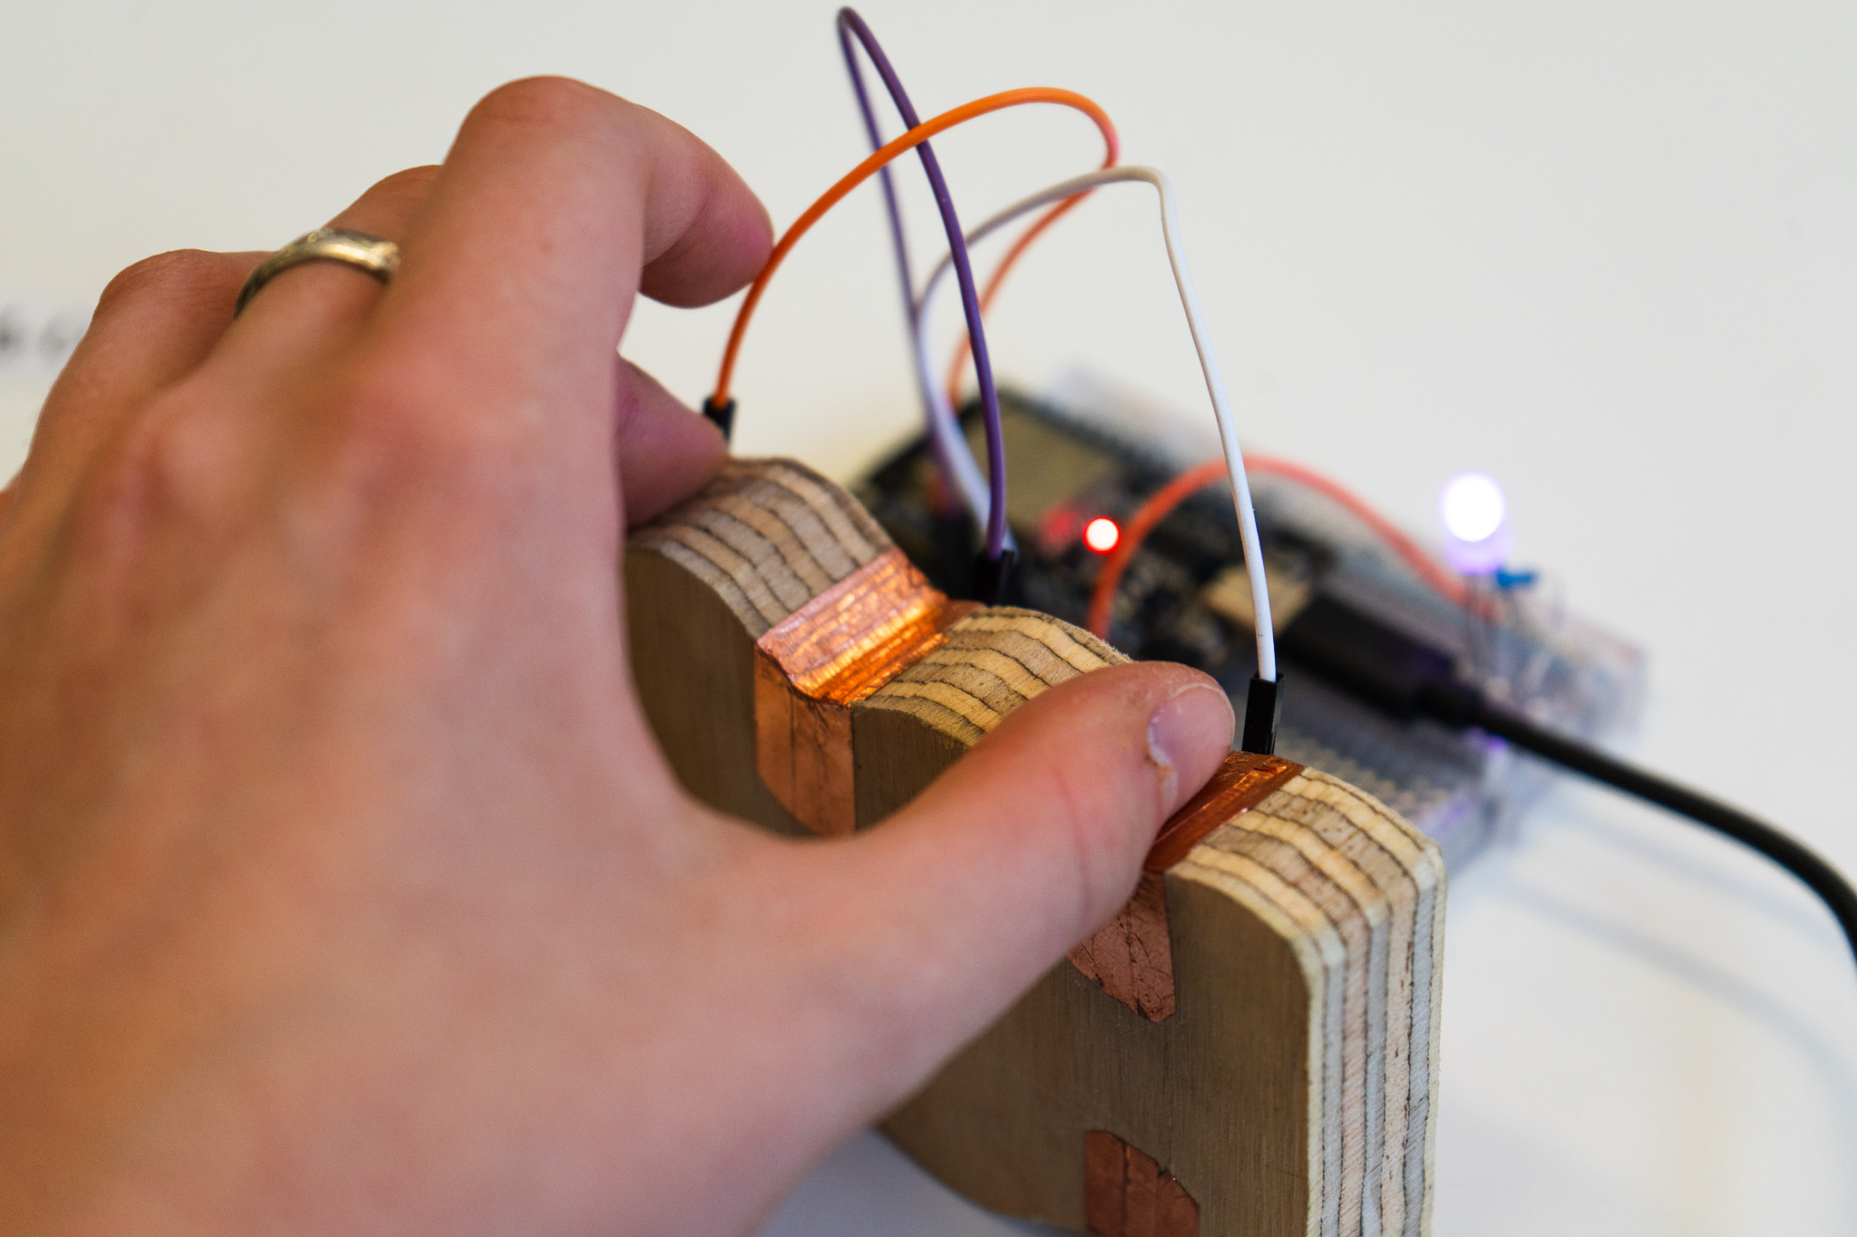
Design Practice I Week 1 Output
Note. Photographs by Sophia Schulz, 2026.
Notes:
Insert dp1 week 1 examples of material and tangible explorations
New materials: weaving, woodworking (band saw and joinery), raster engraving with laser cutting
Rationing constraints: small scale and low time – no “analysis paralysis”; focused on specific materials, forms and interactions rather than complete works; working with conductive materials specifically

Slide 16
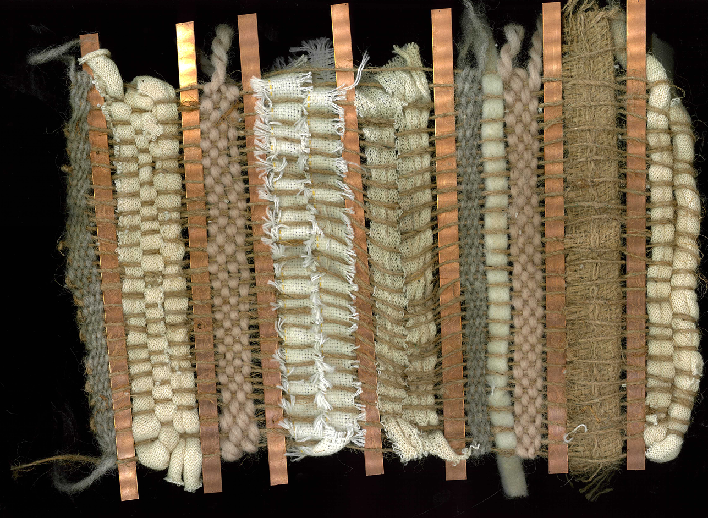
Design Practice I Week 2 Output
Note. Photograph by Sophia Schulz, 2026.
Notes:
New process: weaving with hard and soft materials
Rationing constraints: using scrap textiles/fibres where possible

Slide 17
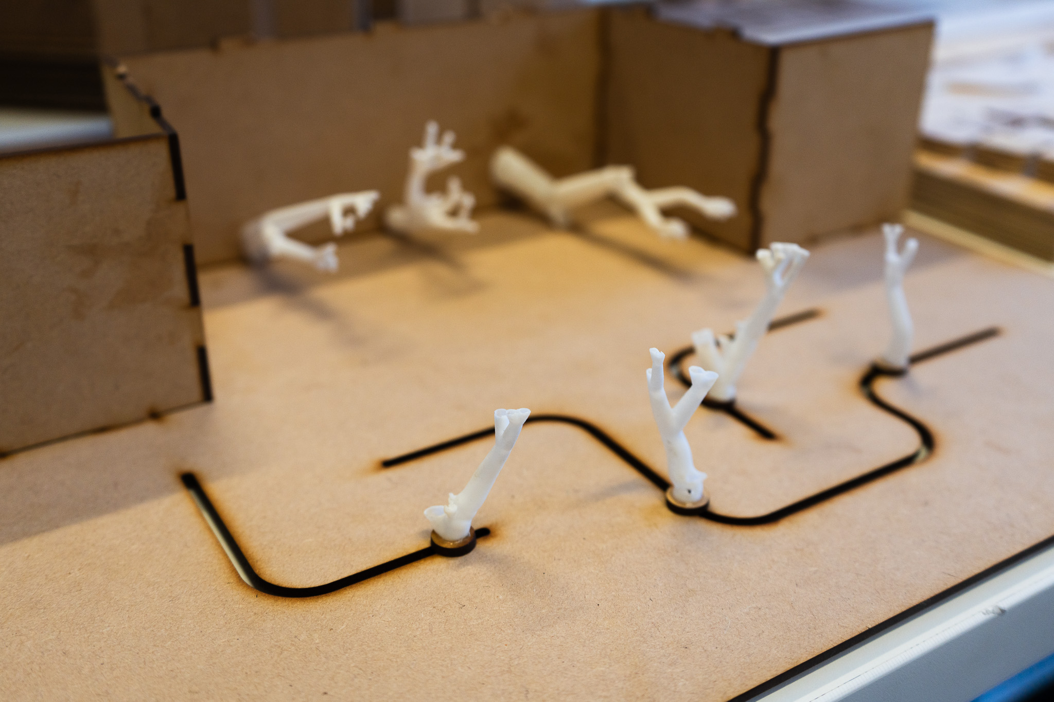
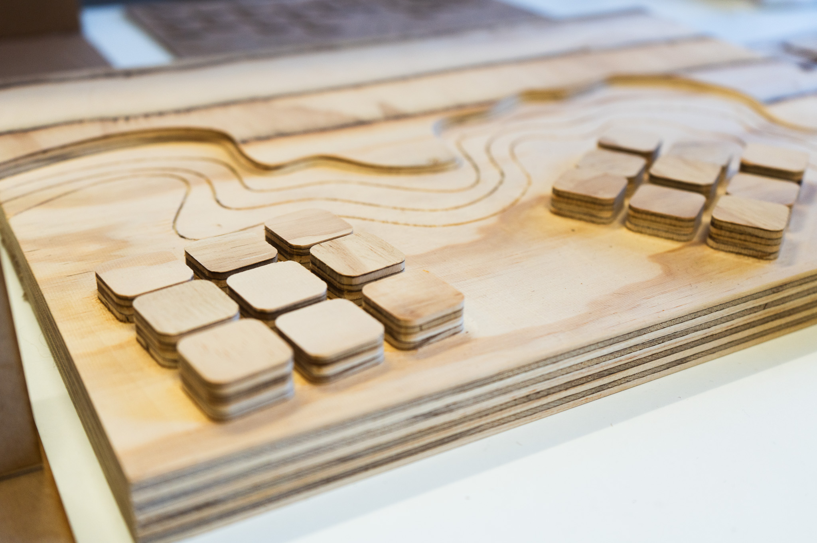
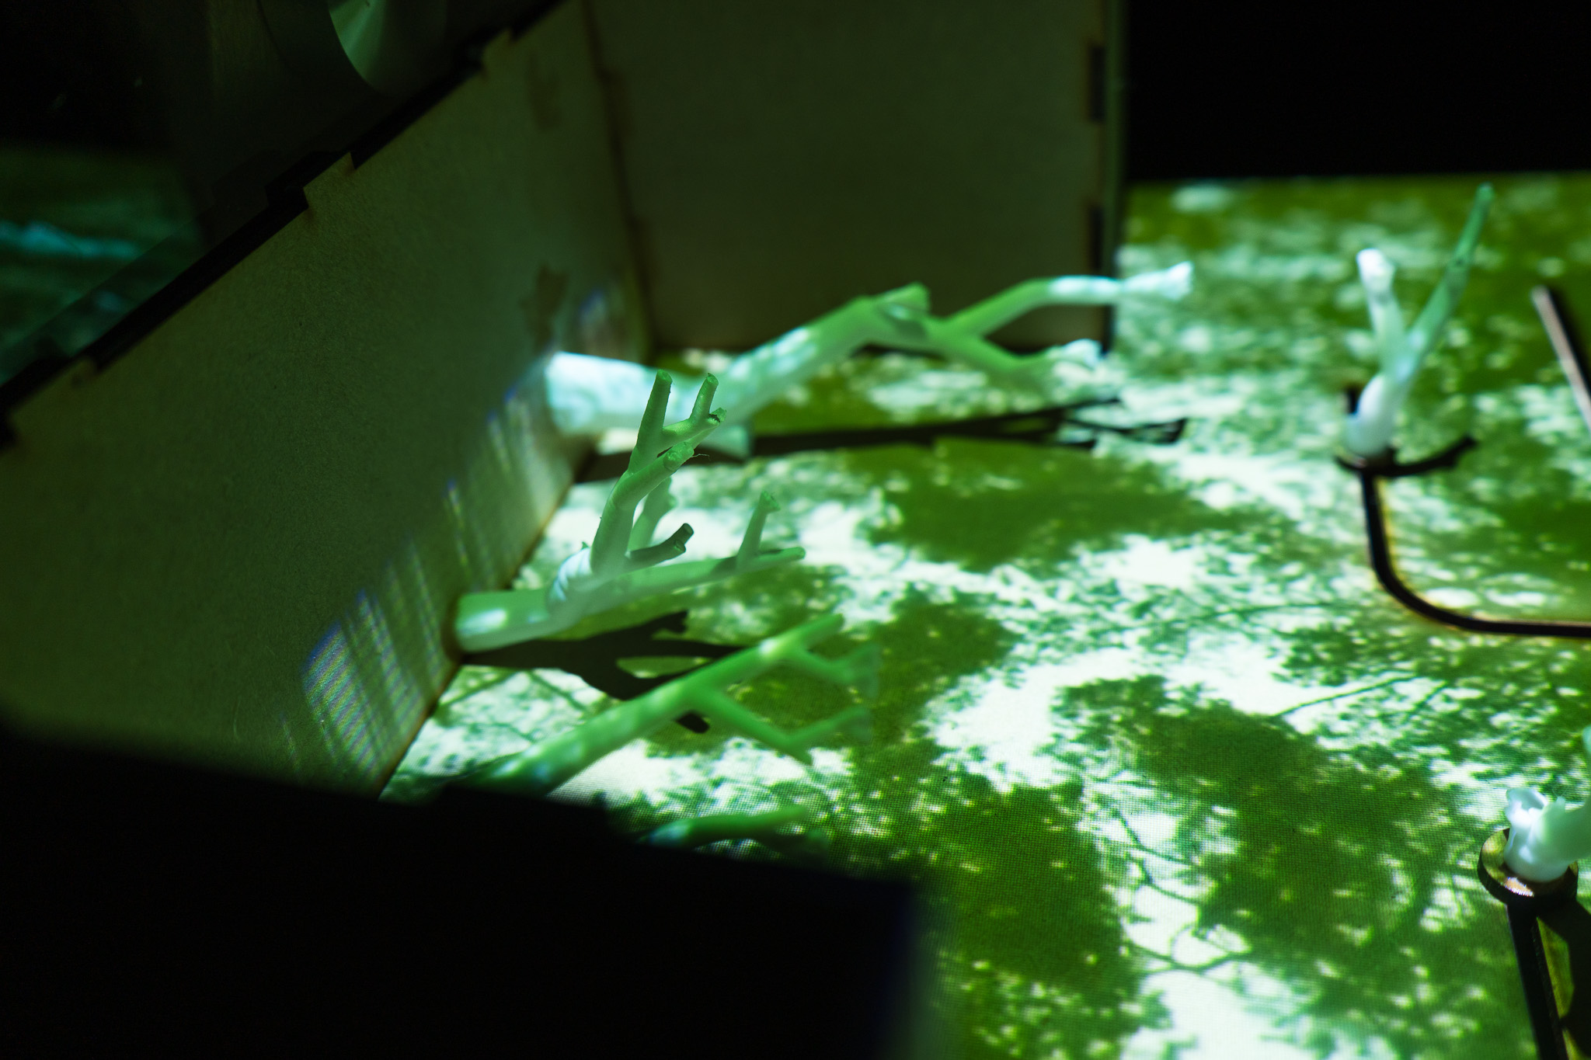
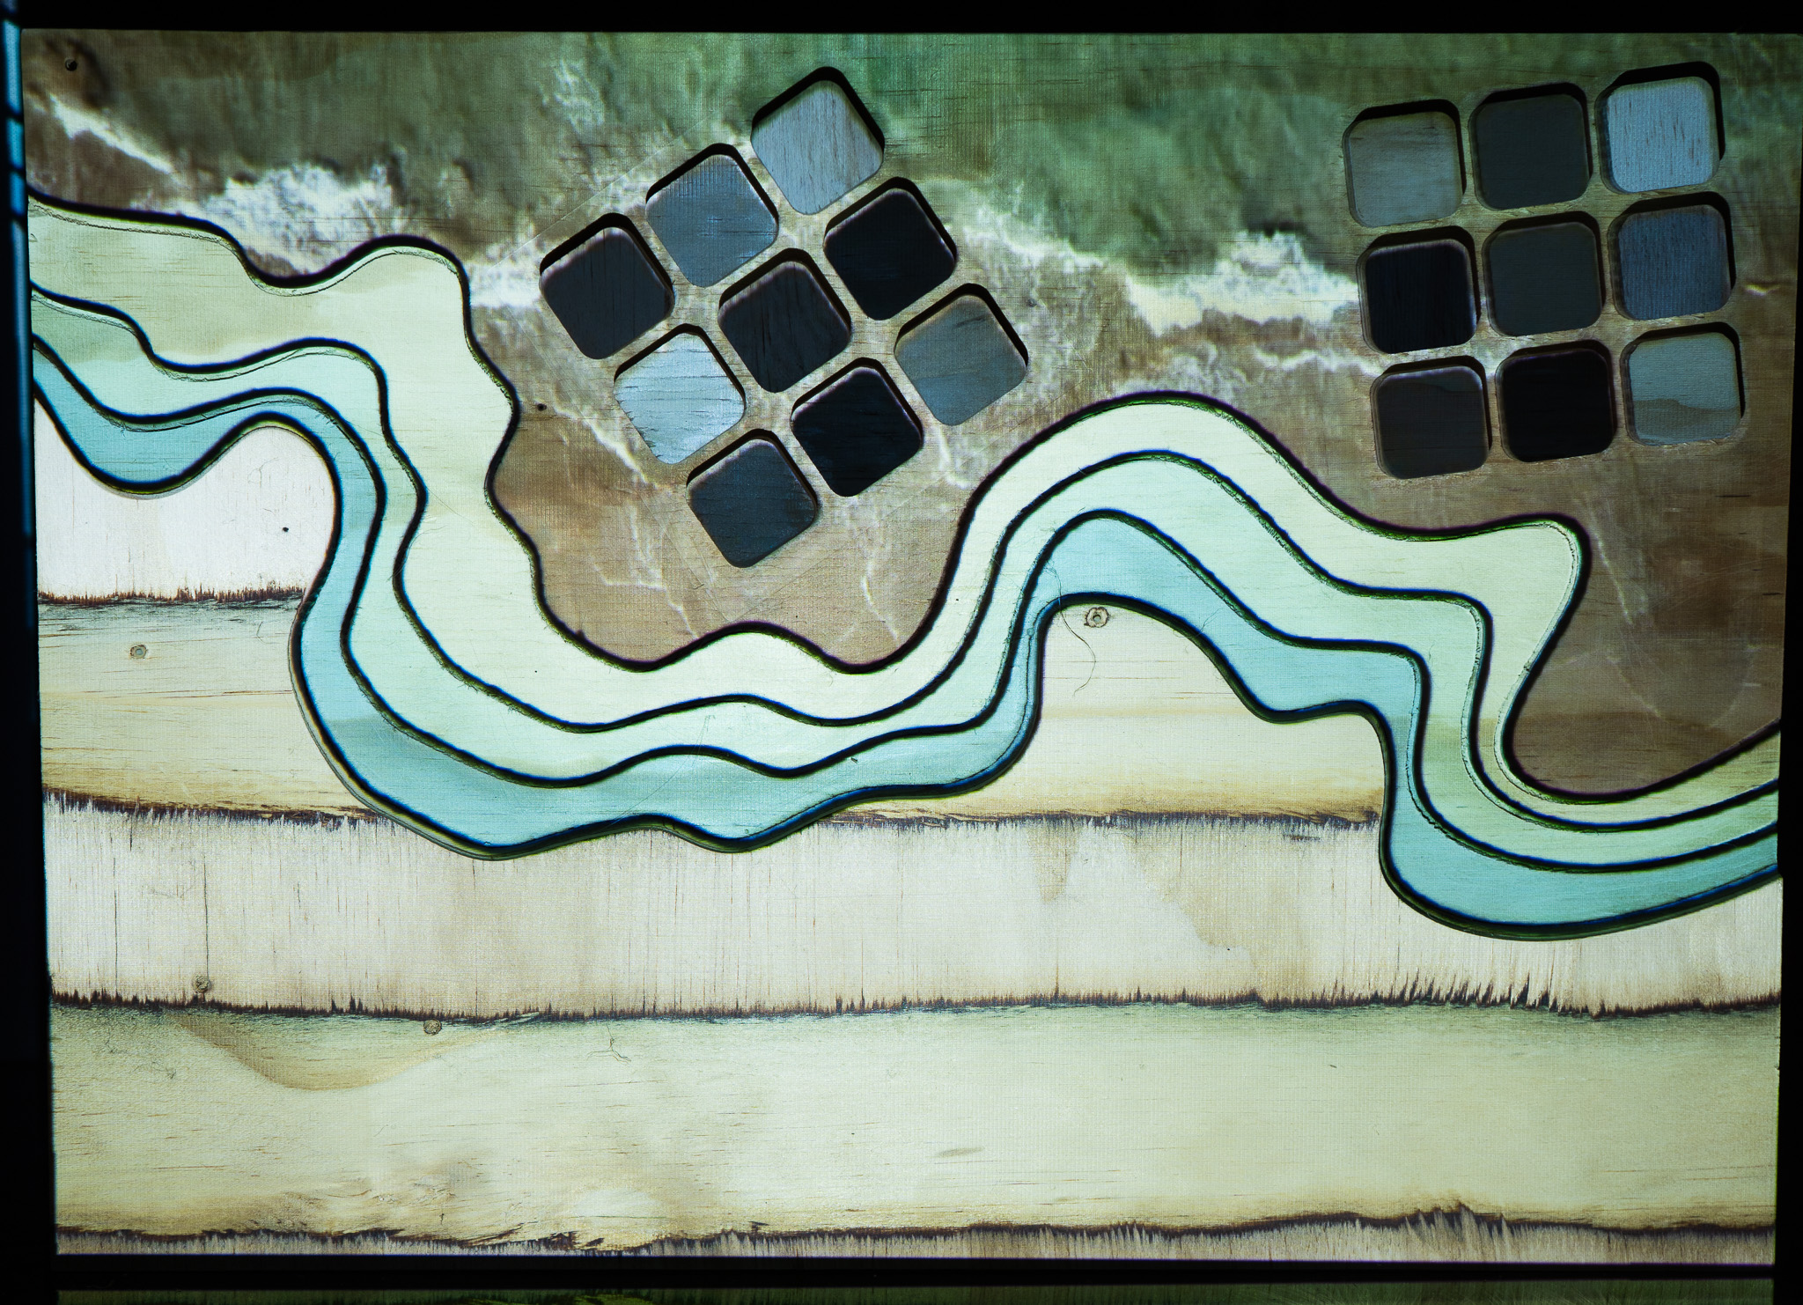
Design Practice I Week 2 Output
Note. Photographs by Sophia Schulz, 2026.
Notes:
Insert examples of dp1 week 2 photo walks and models
New materials/processes: CNC, projection mapping
Rationing constraints: larger scale and longer time meant I could trial projection mapping, but focused on making small-scale models to fit the constraints – this provided much-needed focus for making

Slide 18
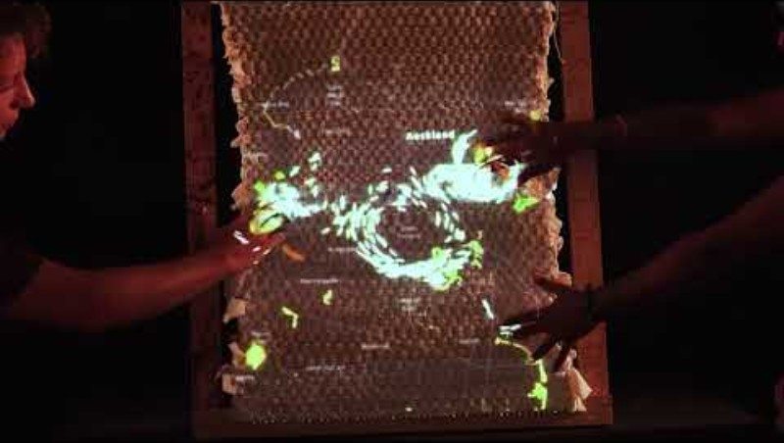
Design Practice I Week 3 Output
Note. Photograph by Sophia Schulz, 2026.
Notes:
Materiality of interaction (tangible interaction), embodied interaction, place-based making/research
Rationing: longer time and no limit on scale meant I could trial a large work and explore tangible and embodied interaction at full-scale; again using scrap materials (wood, textiles, spare copper strips, reusing electronics) where possible

Slide 19
References
Black, Z. (2026). [Zoe Black’s presentation at Te Ao Mahora Wānanga] [Unpublished presentation]. Auckland University of Technology.
Borch, C. (Ed.). (2014). Architectural atmospheres: On the experience and politics of architecture. Birkhäuser.
Dourish, P. (2001). Where the action is: The foundations of embodied interaction. The MIT Press.
Faletau, S. (2026). [Sione Faletau’s presentation at Te Ao Mahora Wānanga] [Unpublished presentation]. Auckland University of Technology.
Franck, K. A., & Stevens, Q. (2006). Loose space: Possibility and diversity in urban life. Routledge.
Hornecker, E., & Buur, J. (2006). Getting a grip on tangible interaction: A framework on physical space and social interaction. Proceedings of the SIGCHI Conference on Human Factors in Computing Systems, 437–446. https://doi.org/10.1145/1124772.1124838
Ishii, H., & Ullmer, B. (1997). Tangible bits: Towards seamless interfaces between people, bits and atoms. Proceedings of the ACM SIGCHI Conference on Human Factors in Computing Systems, 234–241. https://doi.org/10.1145/258549.258715
Johnstone, K. (2026). [Karl Johnstone’s presentation at Te Ao Mahora Wānanga] [Unpublished presentation]. Auckland University of Technology.
Salazar-Miranda, A., Fan, Z., Baick, M., Hampton, K. N., Duarte, F., Loo, B. P. Y., Glaeser, E., & Ratti, C. (2025). Exploring the social life of urban spaces through AI. Proceedings of the National Academy of Sciences, 122(30), e2424662122. https://doi.org/10.1073/pnas.2424662122
Studio Local. (2025). Waimahara [Photograph]. Best Design Awards.
https://bestawards.co.nz/spatial/private-public-and-institutional-spaces/studio-local/waimahara-1/
Tipene, G. (2024). Waimahara [Public art installation]. Myers Park underpass, Auckland, New Zealand. Auckland Council.
Trancik, R. (1986). Finding lost space: Theories of urban design. Van Nostrand Reinhold.
Whyte, W. H. (1980). The social life of small urban spaces. Conservation Foundation.
Notes:
Author, A. A. (Year). Title of presentation [Unpublished presentation]. Institution or course name.
NOTE need to clean up based on what is discussed in presentation

